Slide 1
Tourism Experience Analytics:

Slide 2
Introduction
To develop a machine learning model that involves analyzing user preference and travel patterns based on historical data.

Slide 3
Dataset Overview
The dataset consist of 52000 rows
The dataset is obtained by joining various tables such as transaction, item, user, city, region etc..

Slide 4
Key points implemented
Predicting the Rating
Data cleaning and data preprocessing performed.
Did EDA of data and visualization
Applied RandomForest Regressor algorithm to calculate user rating
Performed encoding and standardization of data
Evaluvation Metrics values
Training RMSE: 0.6859
Testing RMSE: 0.6998
Training R² Score: 0.1115
Testing R² Score: 0.0814

Slide 5
Rating Prediction -Interpretation
From the data it is inferred that R2 value is 0.08.
The current regression model has limited predictive power, it is not necessarily a failure.
Low R² values are common because user preferences are influenced by many unobservable factors while for recommendation system
RMSE value is 0.694. User ratings are subjective and influenced by personal preferences, making perfect predictions unrealistic.
In real-world recommendation systems, RMSE values in the range of 0.6 to 1.0 on a 1-5 scale are common.
RMSE closer to 0.5 would lead to better recommendations and a more reliable system.

Slide 6
Visit Mode Prediction
Predicting the Visit Mode
Data cleaning and data preprocessing performed
Applied XGBOOST classifier algorithm to calculate visit mode prediction
Performed encoding and standardization of data
Training Accuracy : 0.517
Testing Accuracy : 0.480
Testing Precision : 0.462
Testing Recall : 0.480
Testing F1 Score : 0.423

Slide 7
Visit Mode Prediction- Interpretation
The training accuracy (51.9%) and testing accuracy (48.2%) are close to each other, indicating the model is not overfitting to the training data.
This suggests the model is learning patterns that generalize well to new data
.A testing accuracy of 48.2% is reasonable, considering the user preferences.
A precision of 45.1% means that when the model predicts a visit mode, it is fairly reliable.
A recall of 48.2% shows the model is capturing nearly half of the actual visit modes, meaning it is retrieving a significant portion of the true cases.
The F1 score (42.4%) balances both, indicating a moderate but stable classification performance.'''

Slide 8
Content-Based Recommendation System
Saved the sparse similarity matrix as a .npz file for future use
Data cleaning and data preprocessing performed
Converted textual attraction details into a numerical format using TF-IDF
TF-IDF assigns importance to words based on frequency (common words are given lower importance)
Used Nearest Neighbors (n_neighbors=20) to find similar attractions
Applied cosine similarity to measure attraction similarity
Computed nearest neighbors for each attraction
Converted cosine distances into similarity scores
Stored the results in a sparse matrix (efficient for large datasets)

Slide 9
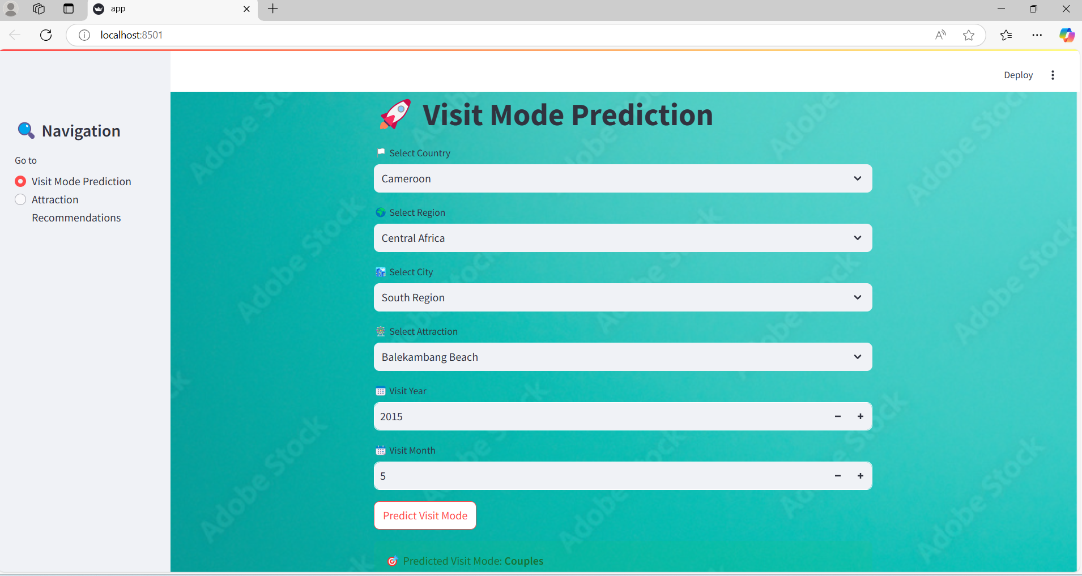
Screenshot-1

Slide 10
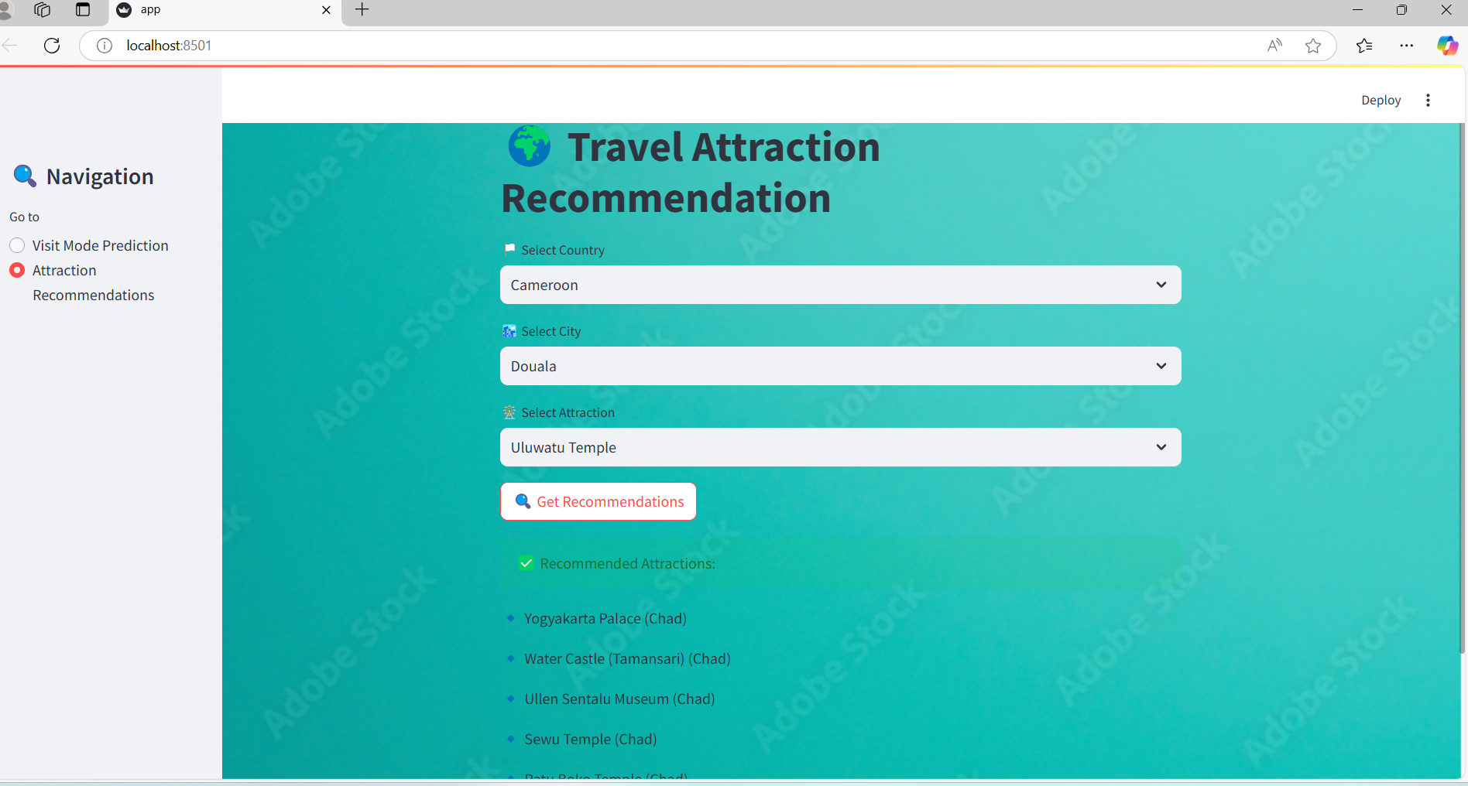
Screenshot-2

